Slide 1

INTRODUCTION to COMPUTATION & PROGRAMMING FOR IE
Assoc. Prof. Dr. Gürkan ÖZTÜRK & Assist. Prof. Dr. Emre ÇİMEN
Hafta 14

Slide 2

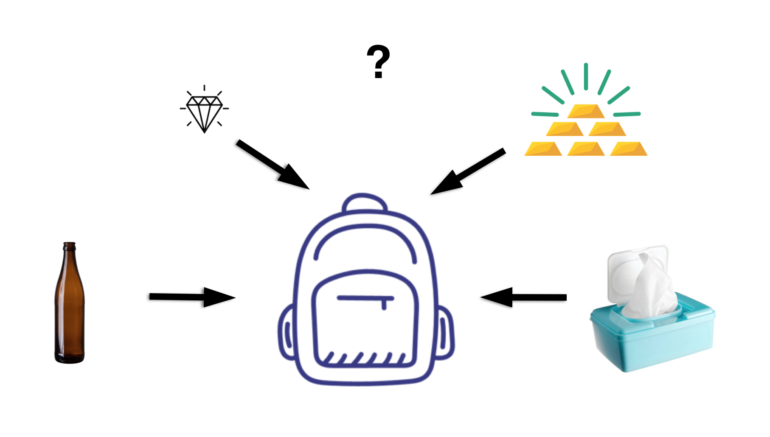
Knapsack Problem
The knapsack problem is a problem in combinatorial optimization: Given a set of items, each with a weight and a value, determine the number of each item to include in a collection so that the total weight is less than or equal to a given limit and the total value is as large as possible.

Slide 3
Knapsack Problem
It derives its name from the problem faced by someone who is constrained by a fixed-size knapsack and must fill it with the most valuable items. The problem often arises in resource allocation where the decision makers have to choose from a set of non-divisible projects or tasks under a fixed budget or time constraint, respectively.

Slide 4
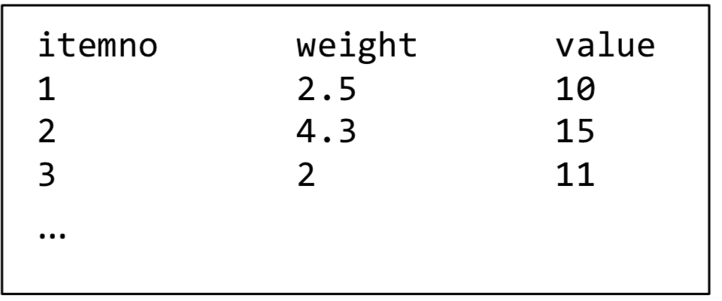
Knapsack Problem
Write a python code to solve a 1D knapsack problem by using following functions:
def sortItem(A, indx):
# This function sorts (decreasing) the matrix A according to given index and returns it.
def putInto(A, C, constIndx):
# This function returns a list that includes selected items according to constIndx. A is the matrix that includes weigts and values. C is the max capacity.
def readFile(path):
# This function reads a txt file in the path and returns the result as a list.
def writeFile(path, Ids):
# This function writes Ids to a txt file to the given path
Main part: Get the capacity from the user. Call necessary functions.

